Slide 1
Back-end Training Chapter 7: Advance Topics in C# By: Prof Rugved V Deolekar (RVD)

Slide 2
Exception Handling
Unexpected event occurs during the execution of the program
Execution of exception handler so that program does not terminate abruptly is called “Exception Handling”
Helps in graceful handling of exception so that program code still can provide the expected results

Slide 3
Exception Handling - Keywords
try
catch
finally
throw

Slide 4
Other Topics
Examples of Runtime Exception – IndexOutOfRangeException
Handling Exception using try .. catch
Multiple catch blocks
Use of finally block
User Defined Exception

Slide 5
Files in C#
It is a collection of data stored using a permanent storage
C# provided functions to read and write data from text files
Program data is volatile so files can be used
It provides the feature of persistency

Slide 6
Reading from a file
File.ReadAllText( ) – reads the complete file in a string
File.ReadAllLines( ) – reads the file line by line and store in array of strings
Using StreamReader class
StreamReader obj=new StreamReader(@”D:\MyData\Sample.txt”);
string str=obj.ReadLine( );

Slide 7
Writing into a file
File.WriteAllText( ) – takes file-path and text-string. It writes the entire file at once
File.WriteAllLines( ) – takes file-path and string array. It writes into a file line by line
Writing using StreamWriter
StreamWriter obj=new StreamWriter(@”D:\MyData\Sample.txt” );
obj.WriteLine(str);

Slide 8
Appending text
To add more text into existing file without overwriting
File.AppendAllText( )- it takes file path and the text string to be appended
Writing using StreamWriter
StreamWriter obj=new StreamWriter(@”D:\MyData\Sample.txt”,true );
obj.WriteLine(str);

Slide 9
Attributes
Used to convey declarative information or metadata
Added using a declarative tag placed within [ ] on top of the required code element
Can have one or more arguments
Derived from System.Attribute class
Two types of Attribute
1) Predefined Attributes
2) Custom Attributes

Slide 10
Properties in C#
Used to provide access to the private members of the class
They can be used as public data members, but they are special methods called accessors
Two type of accessors – get accessor and set accessor
Types of Properties
Read & Write
Read Only
Write Only
Auto Implemented

Slide 11
Creating Properties - Syntax
<access_modifiers> <return_type> <property_name>
{
get { body }
set { body }
}

Slide 12
Creating Properties - Example
class Sample
{
private int num1;
public int Num1
{
get
{
return num1;
}
set
{
num1=value;
}
}
Using Properties:
int z=obj.Num1;
obj.Num1=20;

Slide 13
Creating Properties – Auto Implemented
class Sample
{
public int Num1 { get; set; } – Read Write
public int Num2 { private get; set } – Write Only
public int Num3 { get; private set } – Read Only
}
In this, the corresponding private data members are automatically created by the system.
Using Properties:
int x=obj.Num1;
obj.Num1=10;
int y=obj.Num2; x
obj.Num2=20;
int y=obj.Num3;
obj.Num3=20; x

Slide 14
Delegates and Events
It is an object reference which refers to a method
It’s a reference variable that can hold reference to methods
It specifies which method is to be called when event is triggered
Used to implement the call-back methods and events
Delegates can be chained so that two or more methods can be called on a single event

Slide 15
Creating Delegates - Syntax
Syntax:
[modifier] delegate [return_type] [delegate_name] ([parameters]);

Slide 16
Creating Delegates - Example
Example
public delegate int Sample (int , int);
A delegate can call only a method which has same signature (parameters and return type)
It can be a static as well as a non-static method

Slide 17
Assigning Methods to Delegate
Syntax:
[delegate_name] [obj_name] = new [delegate_name]([calling method name]);
Example:
Sample obj=new Sample(display);
Invoking a delegate:
obj(10, 20);

Slide 18
Multicasting of Delegate
It helps to point more that one method to a single call
All methods are called in FIFO order
+ or += operator is used to add methods to delegate
– or –= operator is used to remove methods from delegate
Multicasting delegate must have return type of void

Slide 19
Example of Multicasting
public delegate void Sample(int x, int y);
public void Add(int a, int b)
{
Console.WriteLine(a+b);
}
public void Sub(int m, int n)
{
Console.WriteLine(m–n);
}
Sample delObj=obj.Add;
delObj+=obj.Sub;
delObj(20, 50);

Slide 20
Func Delegate
Func is in-built type delegate
It can contain minimum 0 and maximum of 16 input parameters
It can contain only one out parameter (the last parameter)

Slide 21
Func Delegate - Syntax
Zero parameters and one result parameter
Func<out PResult> ( );
One parameter and one result parameter
Func<in P, out PResult> (P arg);
Two parameters and one result parameter
Func<in P1, in P2, out PResult> (P1 arg1, P2 arg2)

Slide 22
Func Delegate - Example
public delegate int Sample(int x, int y);
public int Add(int a, int b)
{
return (a+b);
}
Sample obj = Add;
obj(20, 40);
Using Func Delegate:
Func<int, int , int> obj = Add;
obj(20, 40);

Slide 23
Lambda Expression – Anonymous Function
Lambda expression can be used to create anonymous function
Lambda declaration operator => is used to separate lambda’s parameter from its body

Slide 24
Expression Lambda
(input-parameters) => expression
Example
public delegate int DelAdd (int x, int y)
DelAdd obj = (m, n) => m+n;
Console.WriteLine(obj(10, 20));

Slide 25
Statement Lambda
(input-parameters) => { <sequence-of-statements> }
Example
public delegate int SampleDel (int x, int y)
SampleDel obj = (m, n) =>
{
int sum = m+n;
return sum;
};
Console.WriteLine(obj (10 , 20 ));

Slide 26
Multithreading
Traditional method was sequential execution
Multithreading contains multiple threads with single process
Each thread can work on different tasks of a process

Slide 27
Multithreading
Using multithreading multiple tasks execute simultaneously
It works on time-sharing basis, each thread executed for a given time slice without affecting execution of other thread
It helps in maximizing the CPU utilization

Slide 28
Creating and Running Threads
Thread t1=new Thread(Method1);
Thread t2=new Thread(Method2);
t1.Start( );
t2.Start( );

Slide 29
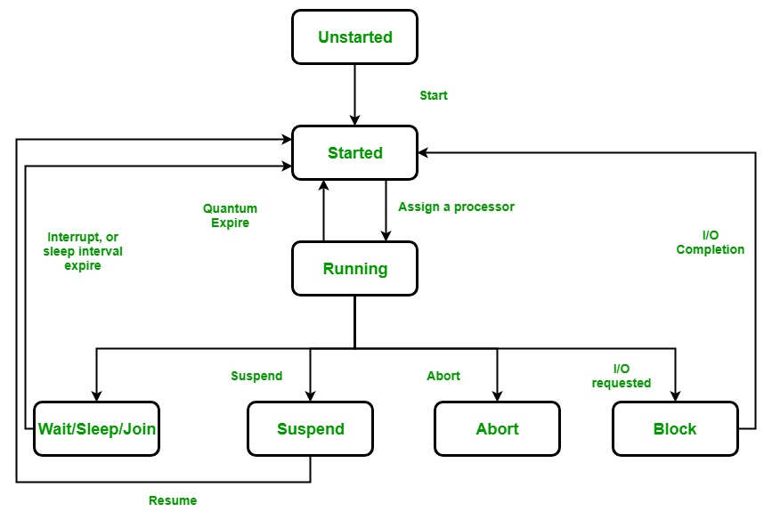
Thread Life Cycle

Slide 30
Thanks

